Slide 1
HPC Report
Enrico Bozzetto
Daniele Spalazzi
Simone Sticca

Slide 2
Introduction to the problem
Solution
Experiment performed
Time execution Results
Memory occupation results
First exercise
Second exercise
Introduction to the problem
Solution
Results
Third exercise
Introduction to the problem
Simulation performed
Performance results
Different boundary conditions

Slide 3
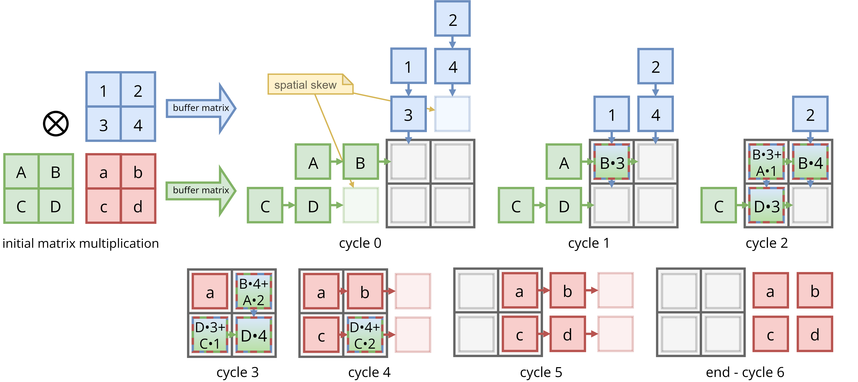
Exercise 1: Introduction to the problem
Systolic arrays are a class of architectures used to solve problems such as large-scale matrix multiplication.
They consist of multiple processing elements (PEs) that exchange data rightward and downward at each clock cycle.
The exercise consists of performing systolic array square matrix multiplication of order 500, 1000, and 2000 with different numbers of PEs.

Slide 4
Solution
The core of the solution is systolicMatricesMultiplication.c, which receives as parameters the matrix order and the iteration number, and uses open MPI to perform the matrix multiplication C=A×B.
This algorithm can also be used for non-square systolic matrices, and each PE stores a local matrix of CCC. The fundamental steps of the algorithm are:
Initialization of the MPI communication environment.
Rank 0 process reads matrices A and B from the input file.
Each process gets its coordinates in the systolic array organization, the local dimensions it needs to store, and the base coordinate it needs to store (absolute coordinate of the top-left element).
The Rank 0 process sends the required rows of A to the first column of the systolic array and the required columns of B to the first row of the systolic array.
At the start of the cycle, each PE evaluates: the number of elements of A to send and receive horizontally and the number of elements of B to send and receive vertically.
Perform the sends and receives, and shift the local matrices.
Add the position-wise product of the local matrices into the local CCC.
Iterate 3 × matrix order times.
Recollect the local C into the final matrix C, stored by the Rank 0 process and save into a csv.

Slide 5
Experiment PERFORMED
The experiments performed are divided according to matrix order, but for each matrix order and process configuration, 10 iterations are executed to gather statistics.
500 order matrix:
single node experiment varying the processes from 1 to 72 with unitarian step size;
double node experiment varying the processes from 4 to 72 with 4 step size;
node number equal to processes number only for 2, 4, 5, 6.
1000 and 2000 order matrix:
single node experiment varying the processes from 4 to 72 with 4 step size.

Slide 6
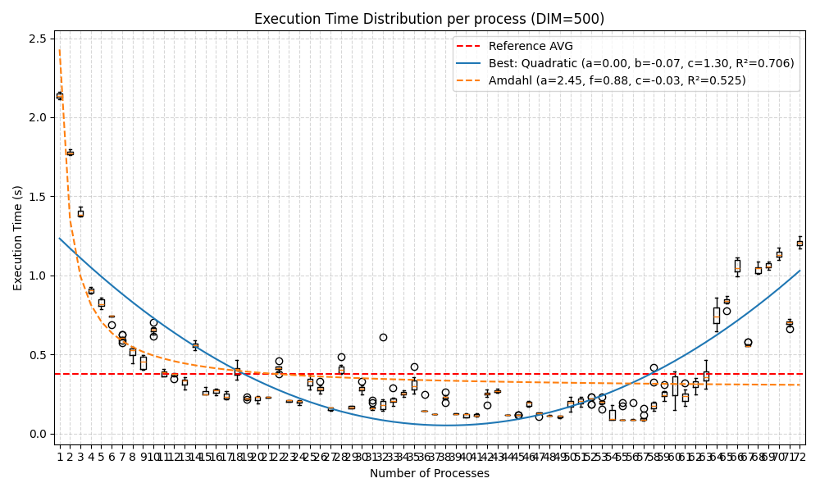
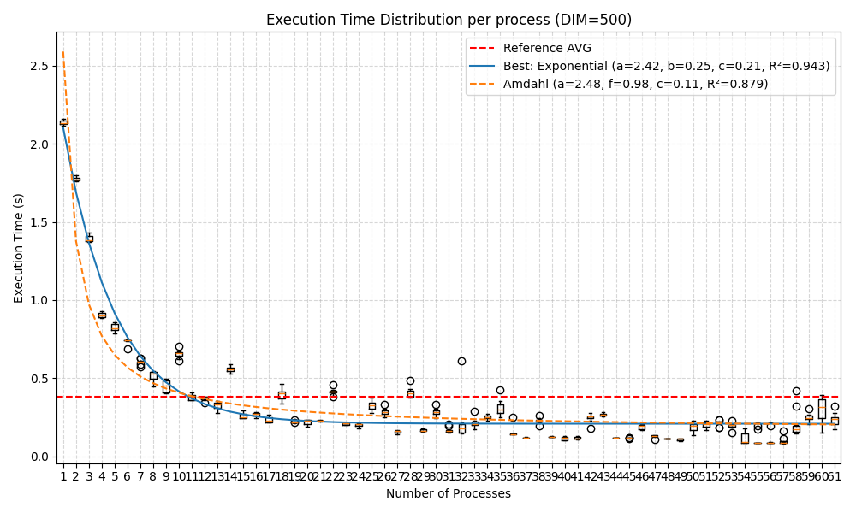
Time execution Results: 500 matrix order, single node
Time execution box-plot with processes from 1 to 72
Time execution box plot with processes from 1 to 61

Slide 7
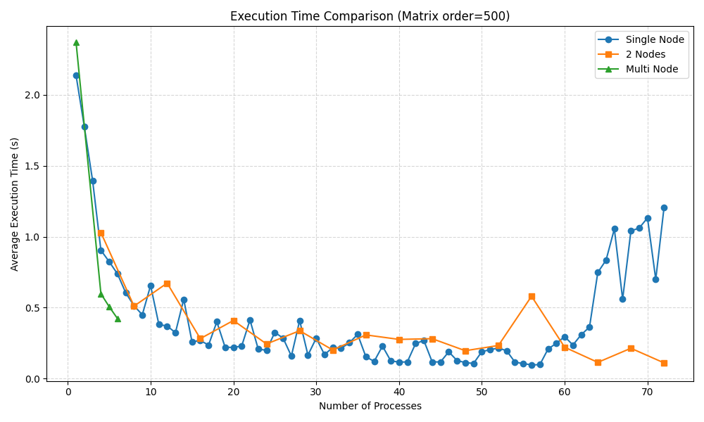
Time execution Results: 500 matrix order comparing different nodes performances

Slide 8
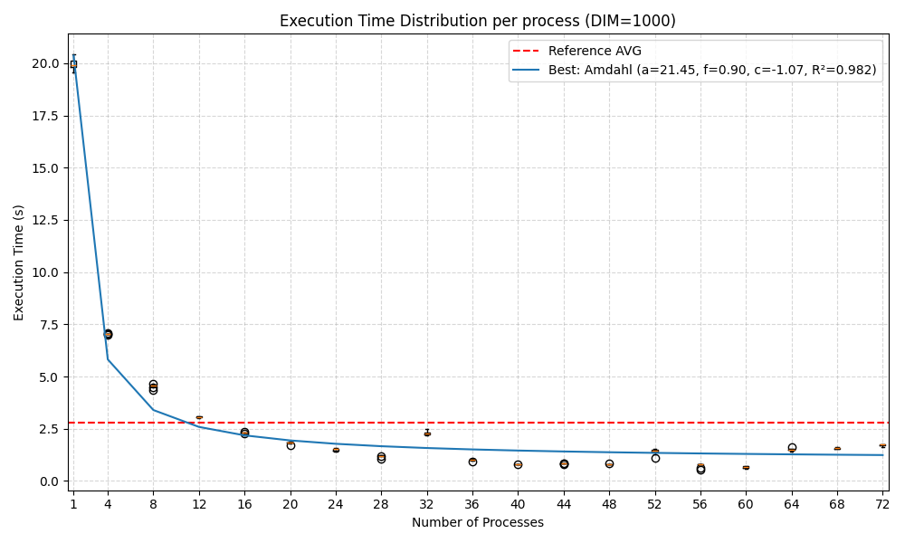
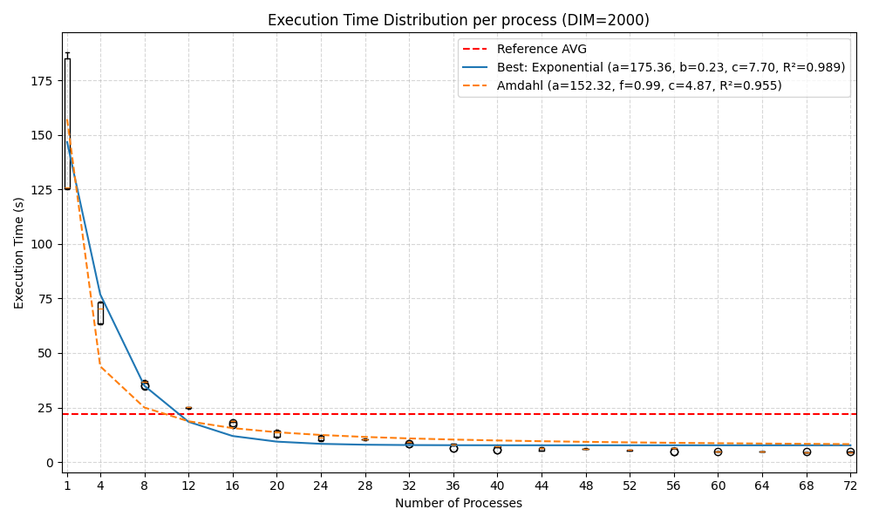
Time execution Results: 1000 and 2000 matrix order, single node
Time execution box-plot with processes from 1 to 72 for 1000 matrix order
Time execution box plot with processes from 1 to 72 for 2000 matrix order

Slide 9
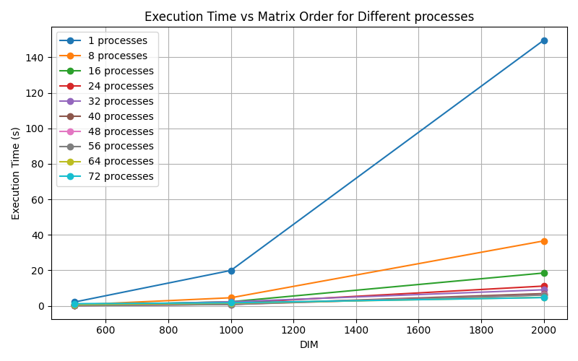
Time execution Results: Comparing 500, 1000 and 2000 execution time

Slide 10
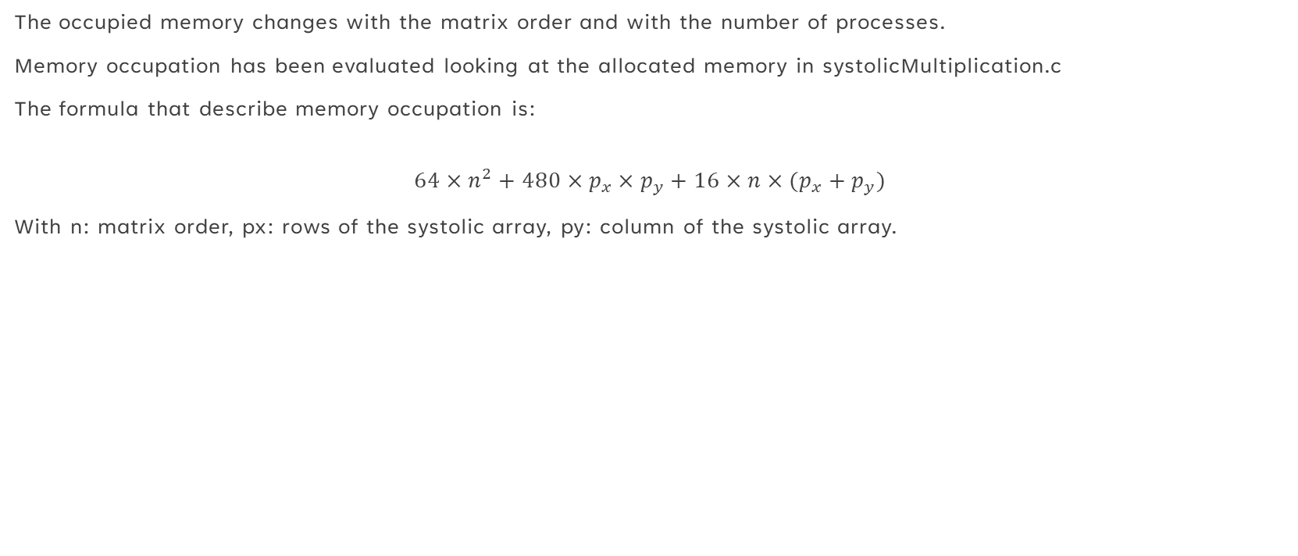
Memory occupation results
The occupied memory changes with the matrix order and with the number of processes.
Memory occupation has been evaluated looking at the allocated memory in systolicMultiplication.c
The formula that describe memory occupation is:
$$64×n^{2}+480×p_{x}×p_{y}+16×n×(p_{x}+p_{y})$$
With n: matrix order, px: rows of the systolic array, py: column of the systolic array.

Slide 11
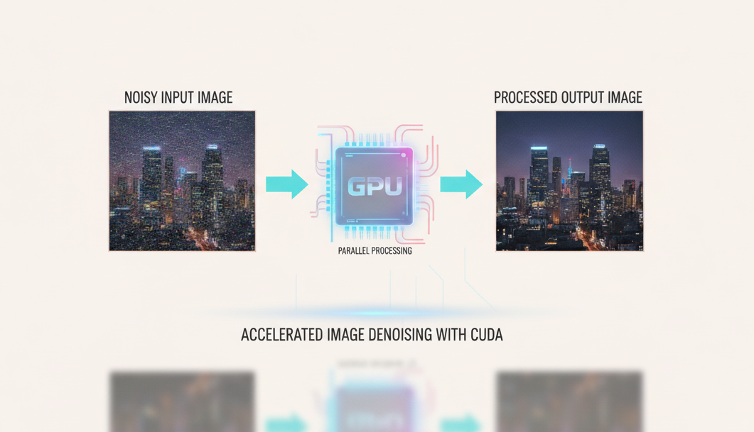
EXERCISE 2- multi-dimensional data processing: INtroduction to the problem
In this project I worked on implementing a CUDA-based filter for noisy images on an HPC system. The goal was to explore how GPU parallelization can improve performance. I started from the problem of image noise reduction, which is common in many computer vision applications, and used a stencil filter as a case study.

Slide 12
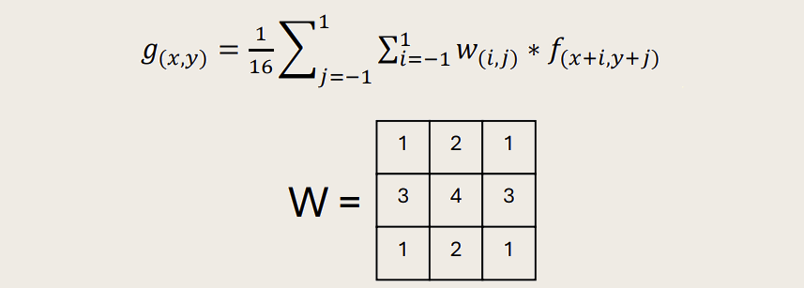
Solution-1
The solution to obtain a better quality was the application of a stencil filter W used to calculate the wheighted average g(x,y), from an input f(x,y). The stencil filter was applied to each components of the image after a decomposition in RGB.

Slide 13
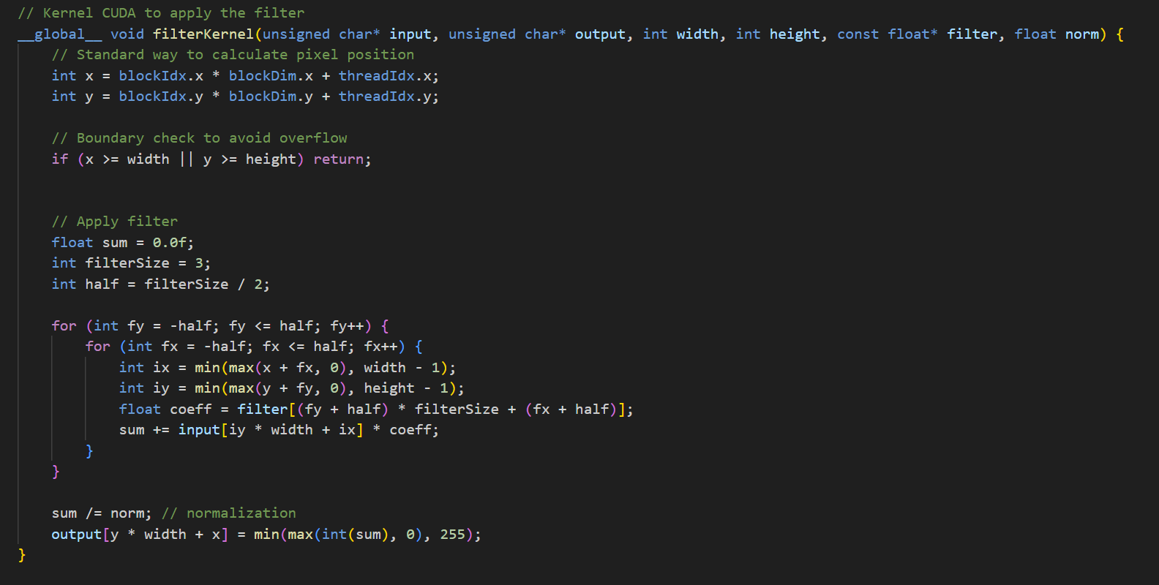
Solution-2
The simulations were ran on the HPC server, using different parameters, like the number of threads and the number of GPUs on one of the give partitions. The images were processed using CUDA and the OpenCV library. The equation was implemented and applied in the kernel function (the function that runs on the device). The filter was applied on diffent types of images, with different resolution or noise.

Slide 14
Results-1
What is seen from the results is that not always using more GPUs and more threads is the best solution. We can see it using different metrics, such as the execution time, to check the performances, and the PSNR(Peak-Signal-to-Noise-Ratio), a metric used to compare an original image with a processed image.

Slide 15
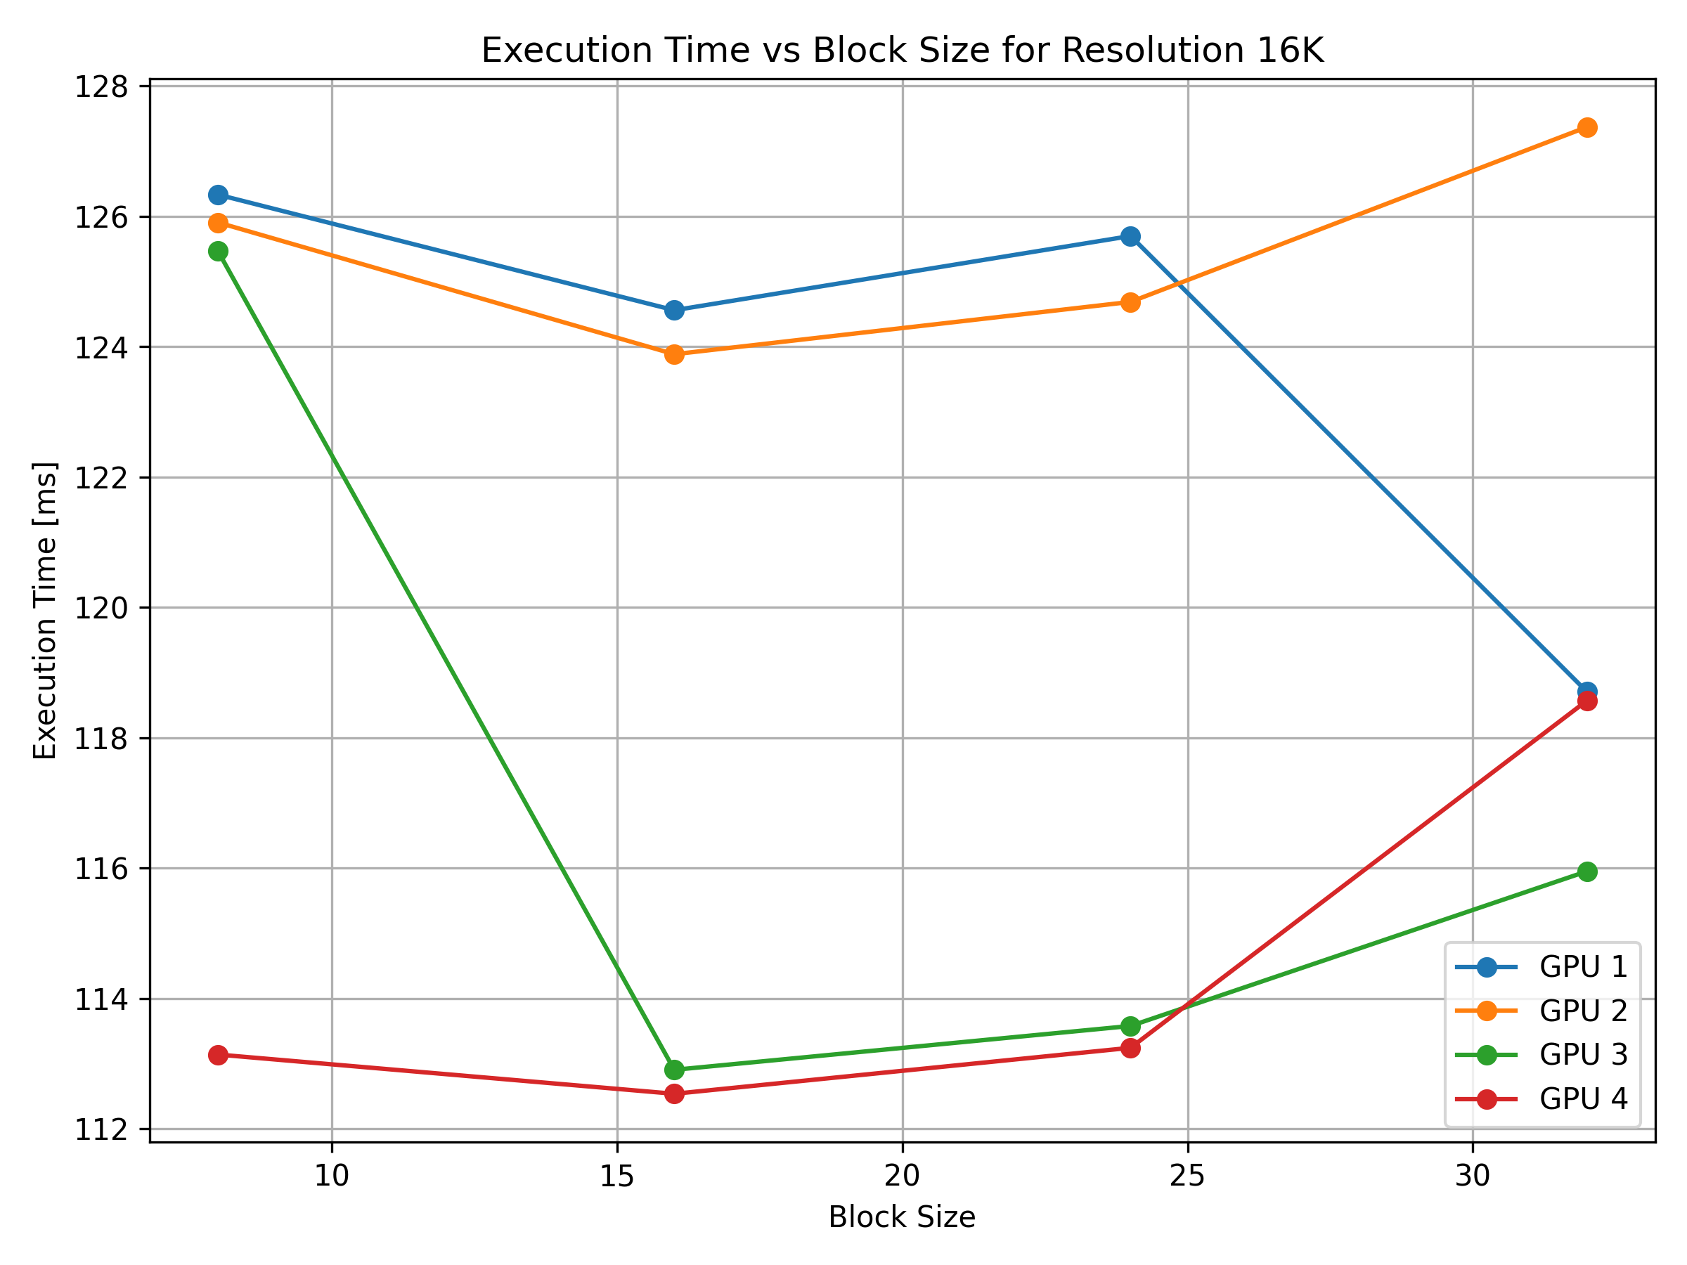
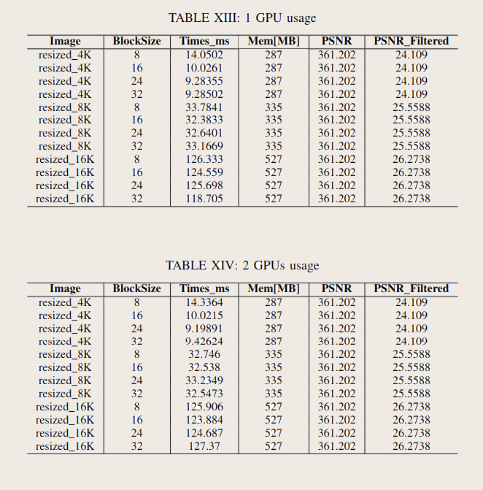
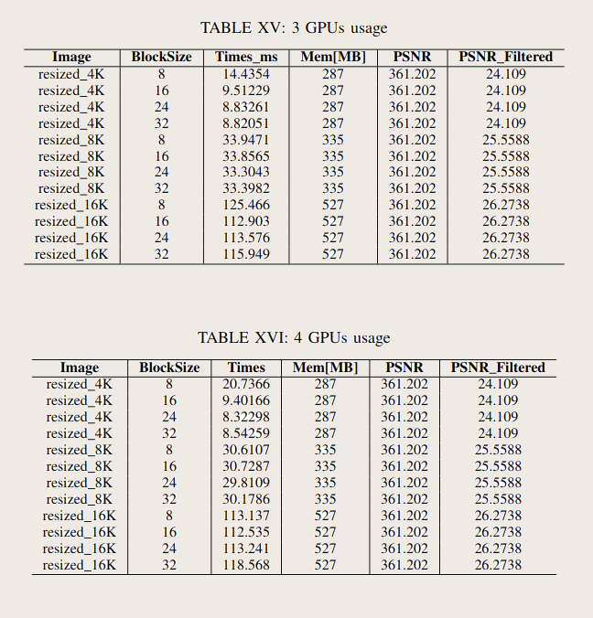
Results-2
Here the results of the application of the stencil filter on different resolution images (4K, 8K, 16K) and the graph about the execution times of the 16K resolution image with different GPUs usage.

Slide 16
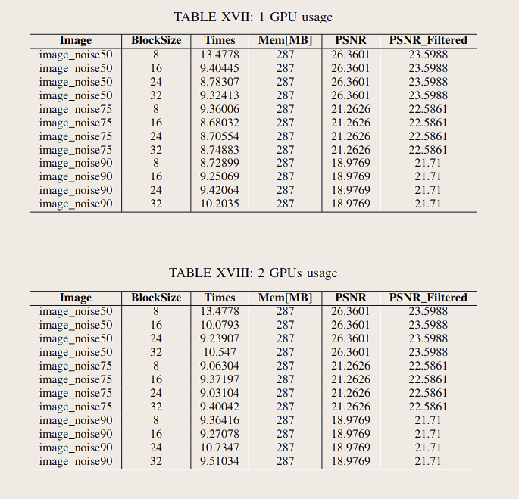
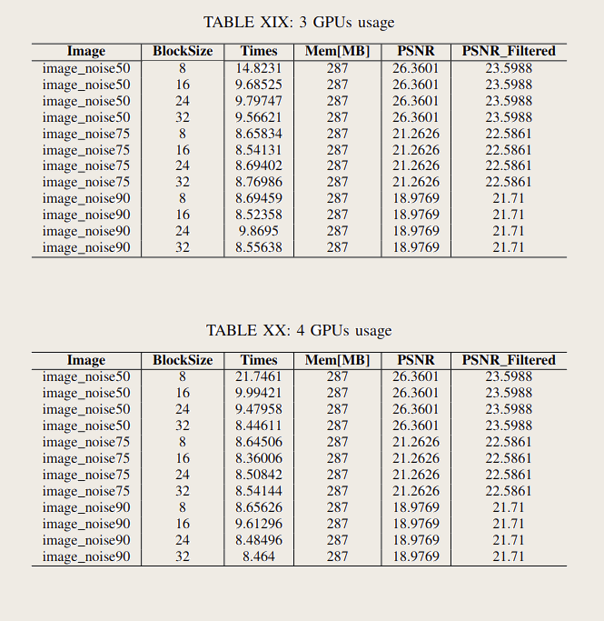
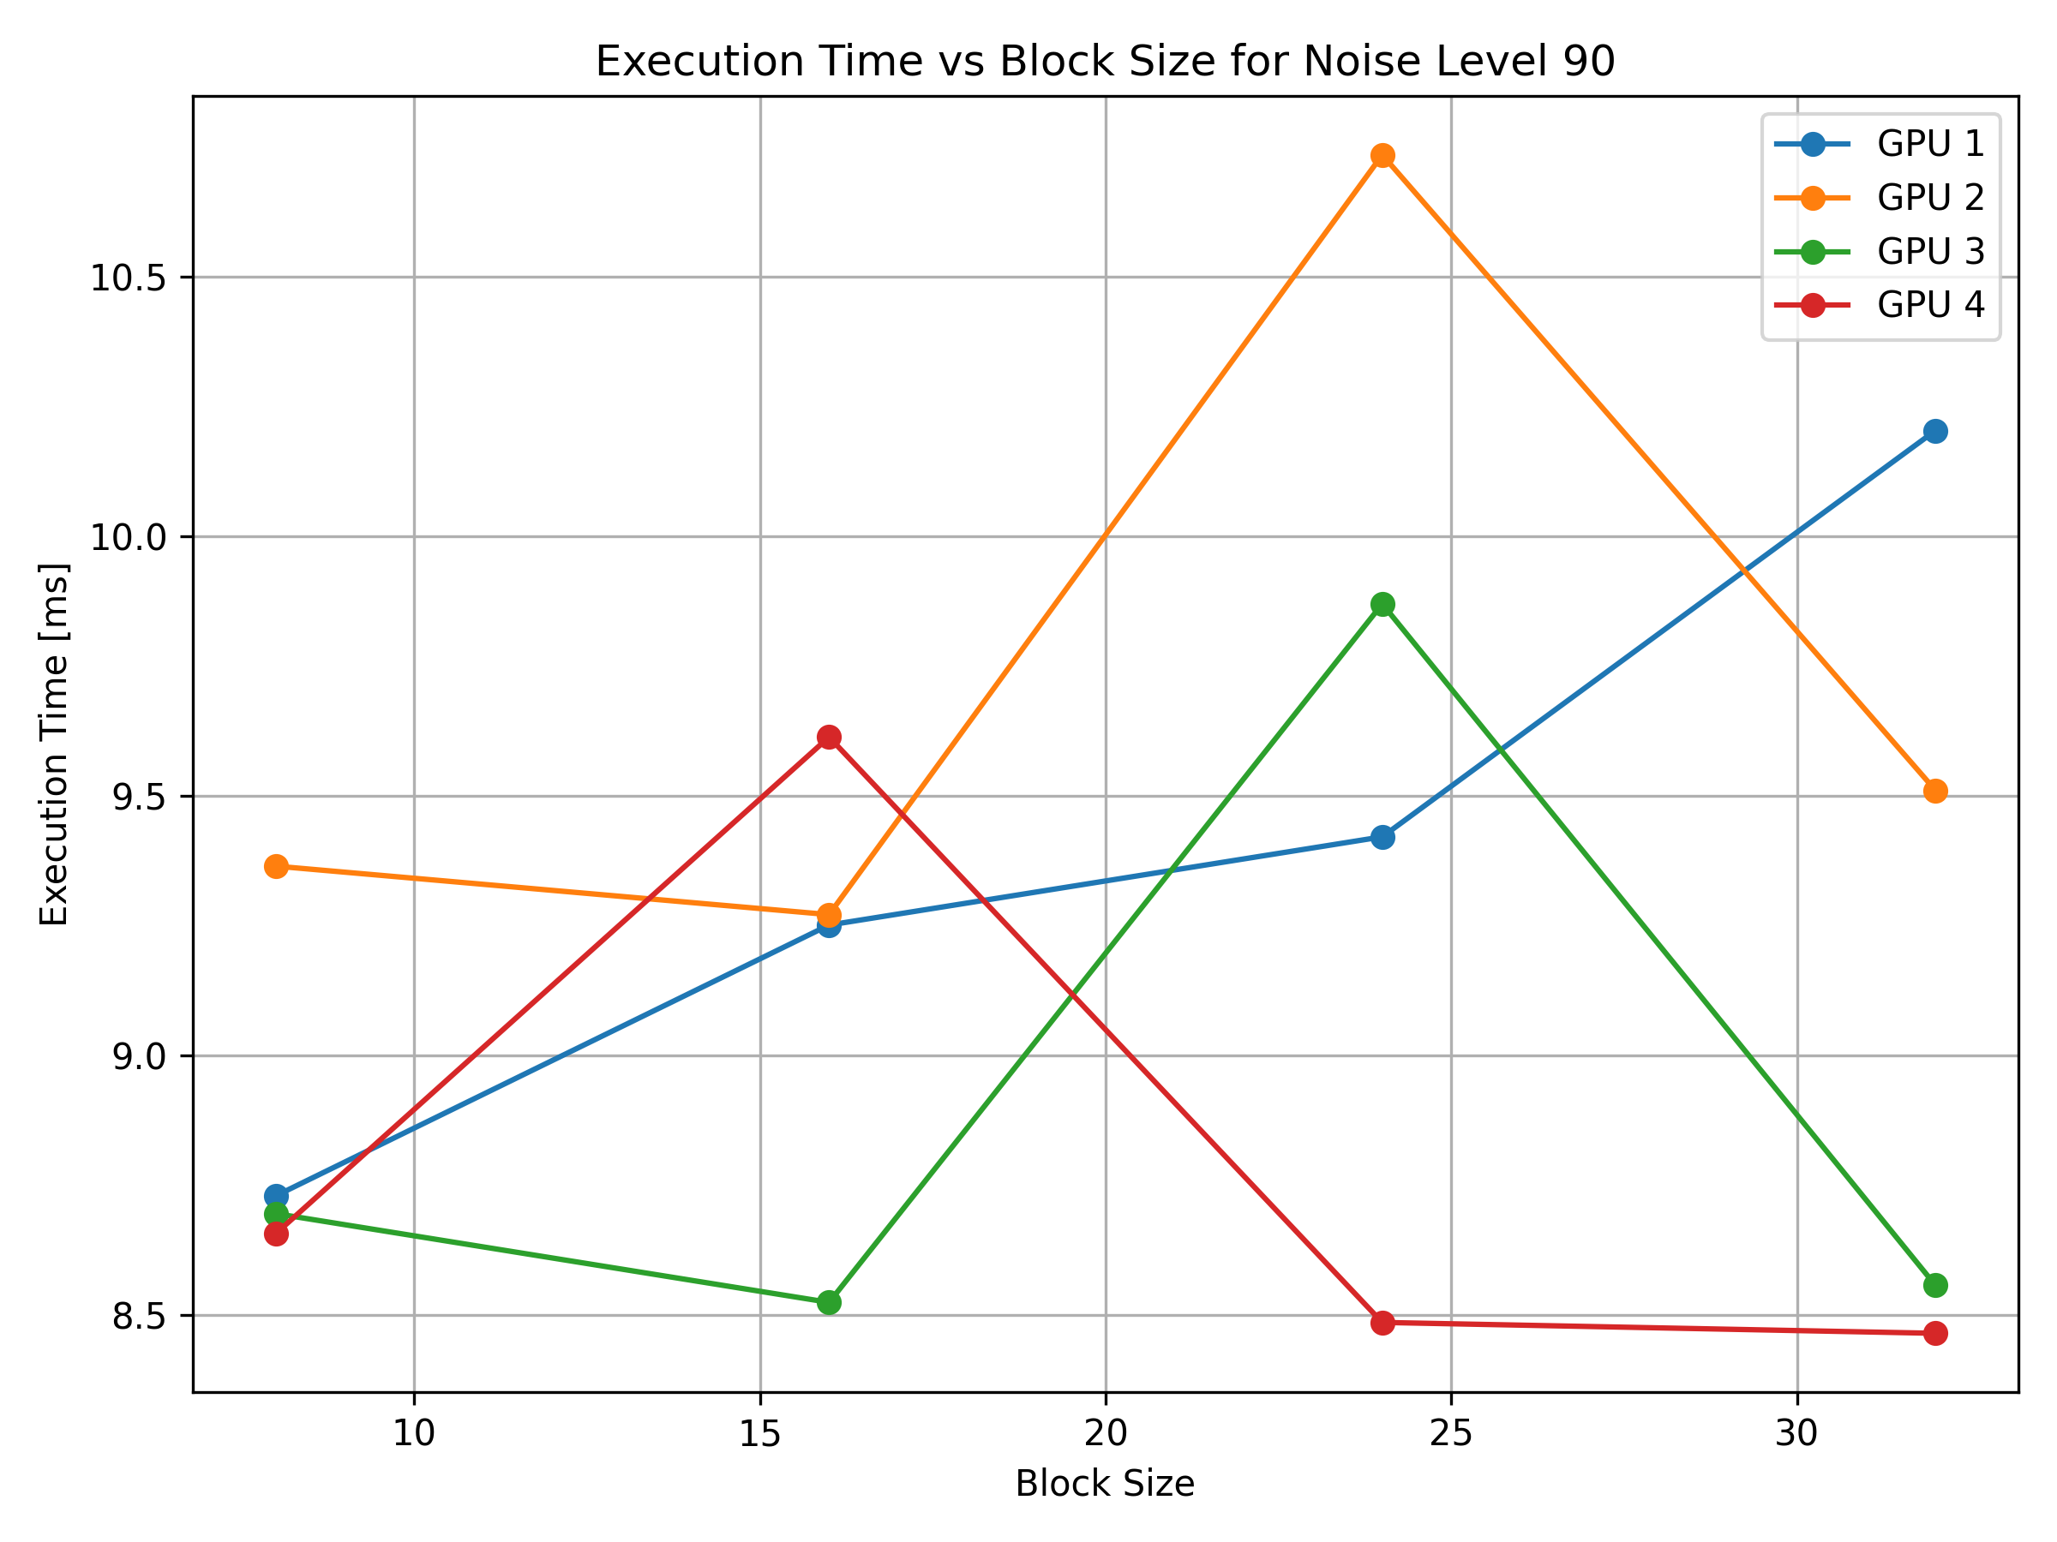
Results-3
Here the results of the application of the stencil filter on different noisy images (50%, 75K, 90K) and the graph about the execution times of the 90% noise image with different GPUs usage.

Slide 17
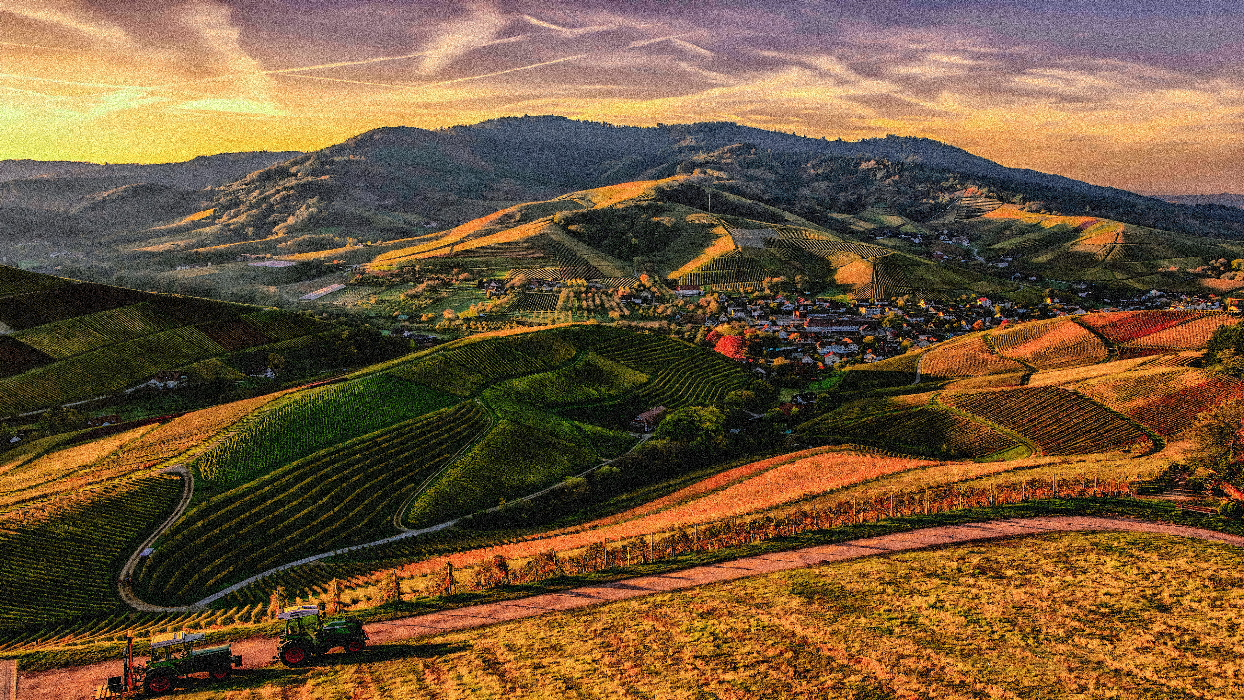

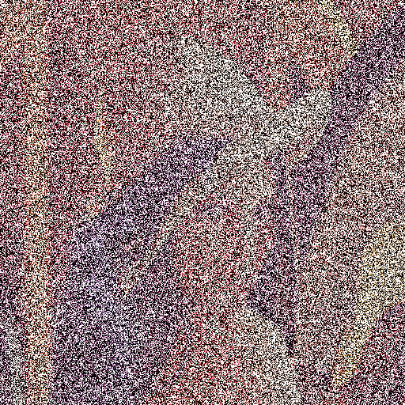
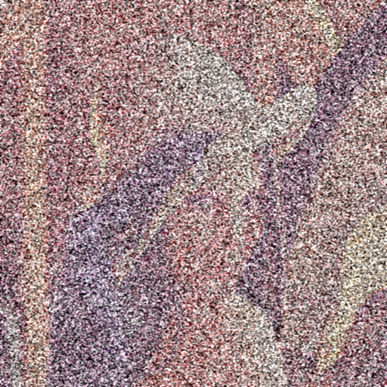
Results-4
Here different images before and after the application of the stencil filter.
4K image with 90% of noise
4K image filtered

Slide 18
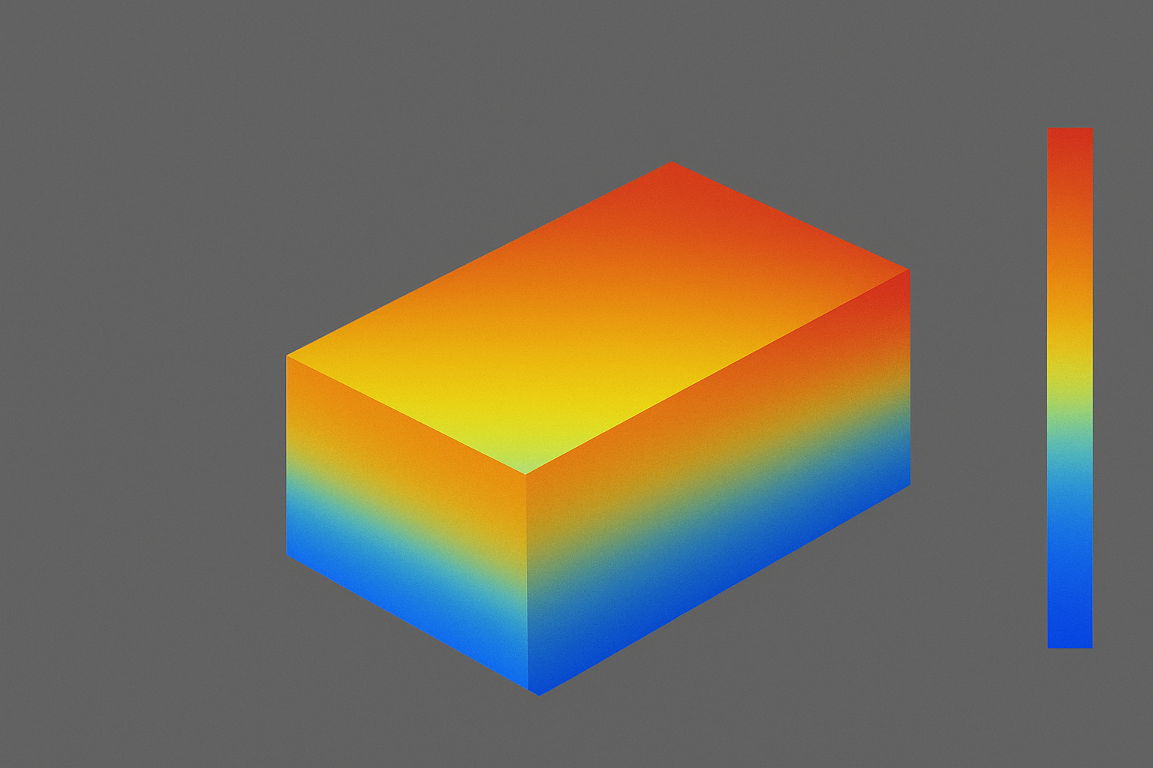
Exercise 3: introduction
The goal of the exercise three is to simulate the heat diffusion in a metallic grid. Heat diffusion is a phenomenon that happens when a gradient of temperature is present in a solid. If this is the case, heat spreads in the solid following some specific rules which depend on the material until an equilibrium condition is reached.
The exercise consists in simulating the heat diffusion in a grid represented by a 1024x1024 grid, using the finite difference method applying two different propagation laws, each one with a different initial condition of the grid.

Slide 19
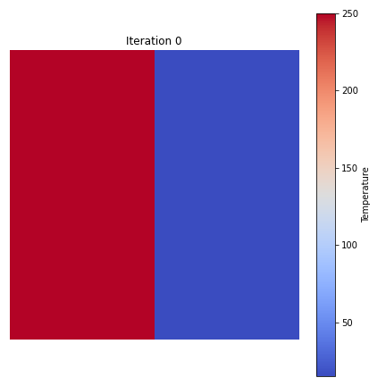
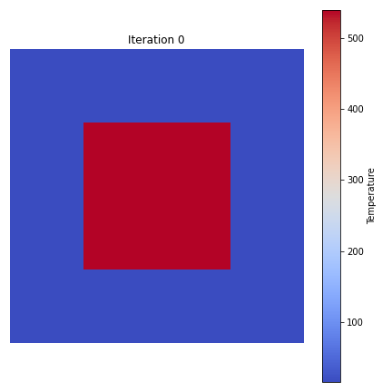
SIMULATION PERFORMED
Simulation is performed in parallel using OpenMP which is an interface which allows to write parallel programs in C, C++ or Fortran for shared-memory computers. Simulations are then performed with a C code using OpenMP changing number of iterations and number of threads used. Then an analysis of performances is performed, as requested.
The two cases simulated are the following ones:
the first case consists in having half of the grid at 250°C and half at earth's average T (15°C) as in the picture under.
the second case consists in having the central quarter of the grid at 540°C and the rest at 15°C as in the picture under.
The propagation law in this case is that every cell' T is the average of its four neighbors.
The propagation law in this case differs horizontal and vertical propagation weighting them with two coefficients, respectively equal to 0.3 and 0.2.

Slide 20


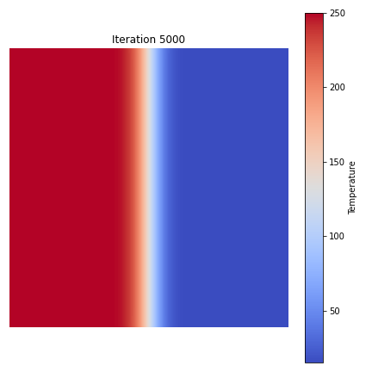
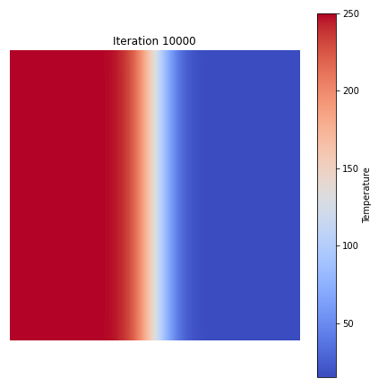
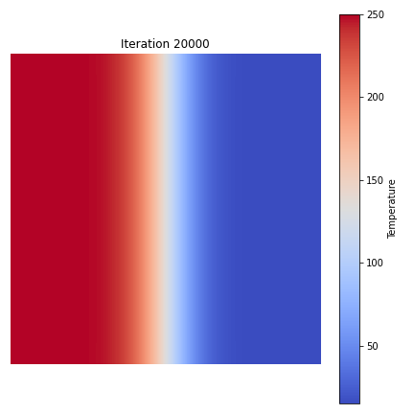
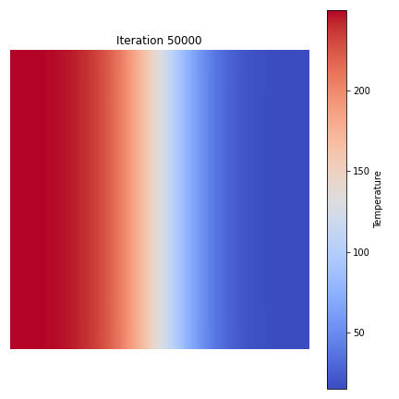
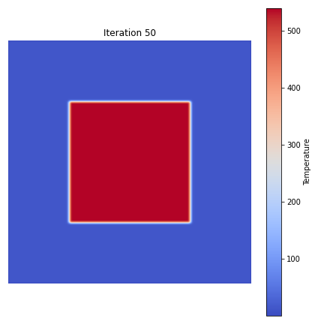
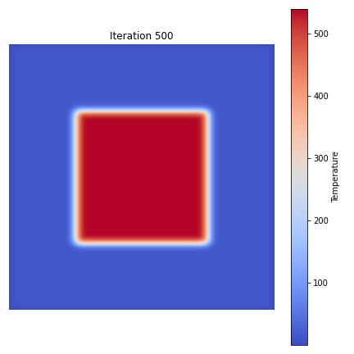
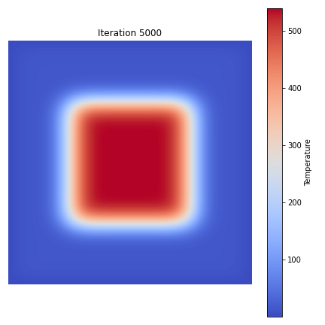
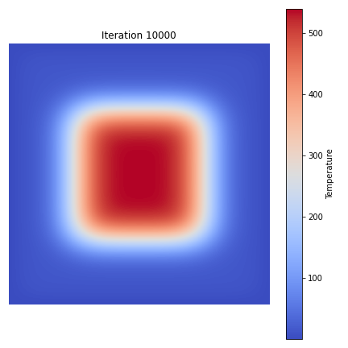
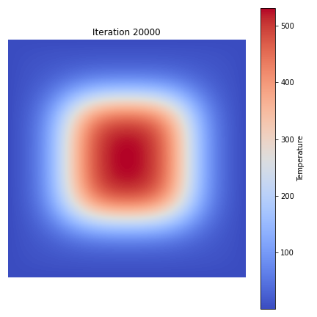
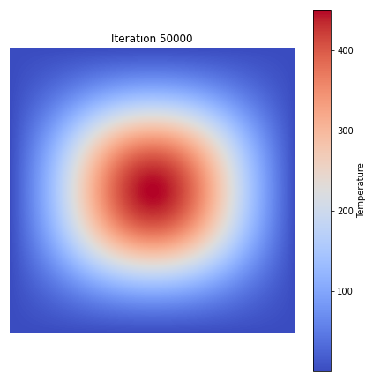
SIMULATION PERFORMED II
The exercise requires to simulate both the cases with maximum number of iterations equal to 10000. To represent the heat propagation at different steps and so evaluate performances 6 simulations were performed: the first with 50 max. iterations, the second with 500, then 5000, 10000 and two extras with 20000 and 50000.
All of them are simulated with a number of threads going from 1 to 11: the first 10 cases are used to obtain execution times of the simulations, while the last is used only to print the grid values to represent it in heatmaps. All the simulations are performed using the two different initial conditions and propagation laws.

Slide 21
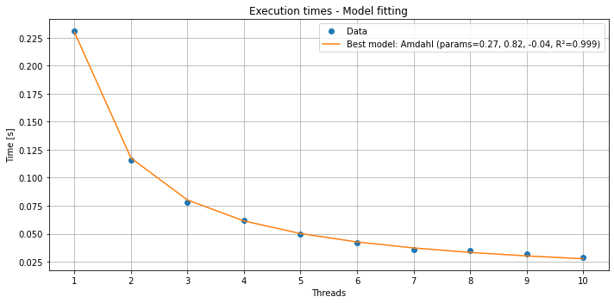
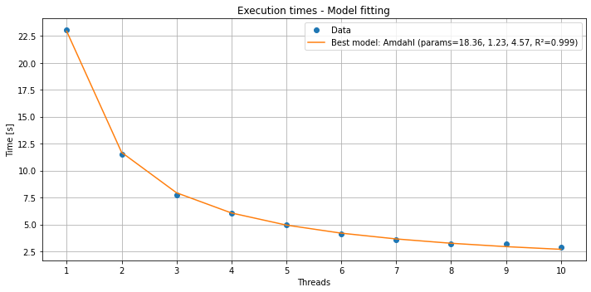
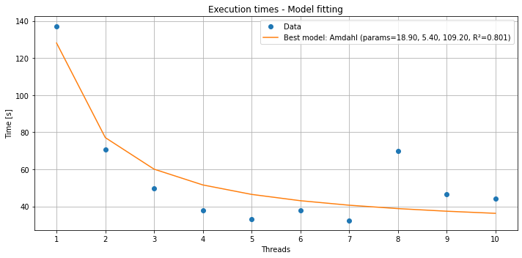
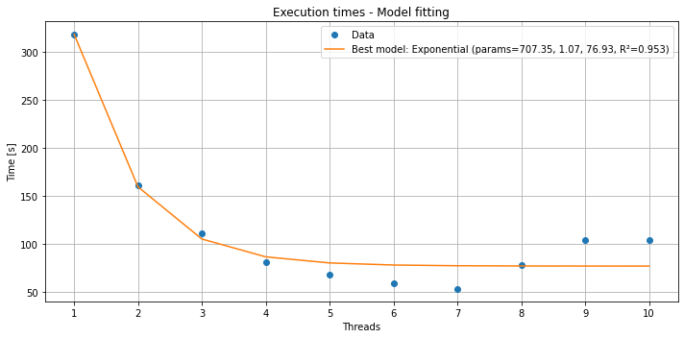
PERFORMANCE RESULTS
Performances are evaluated in terms of execution times, speedup and efficiency as the number of threads varies for every simulation performed. Here execution times trends are reported for 50, 5000, 20000 and 50000 iterations.

Slide 22
DIFFERENT BOUNDARY CONDITIONS
At the end different boundary conditions were simulated with the first propagation law and with 10000 iterations to see which one is the most efficient one. The first used for all the simulations considered that edges cells had only 3 neighbors, while corners cells only 2. The other B.C. used are: Dirichlet B.C. (edges cells are fixed at the initial values), Neumann B.C. (the missing neighbor is reflected so every cell has always 4 neighbors) and periodic B.C. (opposite edges of the grid are considered to be in contact).
Initial B.C.
Dirichlet B.C.
Neumann B.C.
Periodic B.C.
Threads | Time[s]
1 | 46.06
2 | 22.96
3 | 15.73
4 | 12.11
5 | 9.91
6 | 8.26
7 | 7.23
8 | 6.79
9 | 6.41
10 | 5.76
Threads | Time[s]
1 | 33.59
2 | 17.11
3 | 11.64
4 | 8.67
5 | 7.49
6 | 6.37
7 | 5.74
8 | 5.06
9 | 9.54
10 | 8.75
Threads | Time[s]
1 | 62.21
2 | 32.77
3 | 23.50
4 | 17.60
5 | 14.88
6 | 13.59
7 | 12.76
8 | 10.94
9 | 16.00
10 | 15.15
Threads | Time[s]
1 | 38.29
2 | 19.36
3 | 13.22
4 | 10.09
5 | 8.41
6 | 7.18
7 | 6.24
8 | 5.66
9 | 10.52
10 | 10.38

Slide 23
Thank you for the attention
Enrico Bozzetto
s339473@studenti.polito.it
Daniele Spalazzi
s346877@studenti.polito.it
Simone Sticca
s347328@studenti.polito.it

